Slide 1
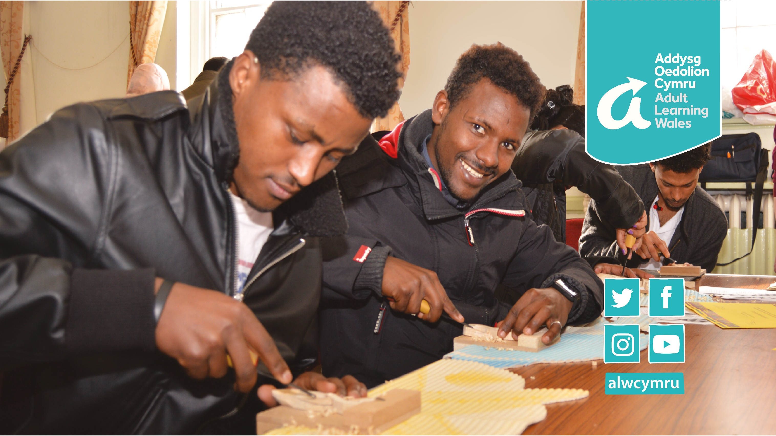



Addysg Oedolion Cymru
Prosiect Camau at Integreiddio Llwyddianus
Adult Learning Wales
Steps to Integration Success Project
Ariennir y prosiect hwn yn rhannol trwy Gronfa Integreiddio ac Ymfudo Lloches yr Undeb Ewropeaidd. Er mwyn rheoli llif ymfudiad yn fwy effeithlon ledled yr Undeb Ewropeaidd.
This project is part-funded through the European Union Asylum Migration and Integration Fund. Making management of migration flows more efficient across the European Union.

Slide 2

Cyflwyniad i Brosiect Camau at Integreiddio Llwyddianus
Introduction to Steps to Integration Success Project
Ariennir gan Gronfa Integreiddio ac Ymfudo Lloches yr Undeb Ewropeaidd.
Nod y prosiect - darparu’r sgiliau, y wybodaeth, y cyfleoedd a’r cymorth i wladolon y tu allan i’r UE a’r tu allan i’r AEE, gan gynnwys ffoaduriaid, i ddod yn fwy integredig i gymdeithas y DU.
Ers 2020, mae 688 o unigolion sy’n byw yng Nghymru wedi cael cymorth drwy’r prosiect.
Rhagwelir y bydd y prosiect yn cau ym mis Rhagfyr 2023.
Funded by the European Union Asylum Migration and Integration Fund.
Project aim – to provide non-EU and non-EEA nationals, including refugees, the skills, knowledge, opportunities and support to become more integrated into UK society.
Since 2020, 688 individuals living in Wales have received support through the project.
The project is expected to close in December 2023.

Slide 3
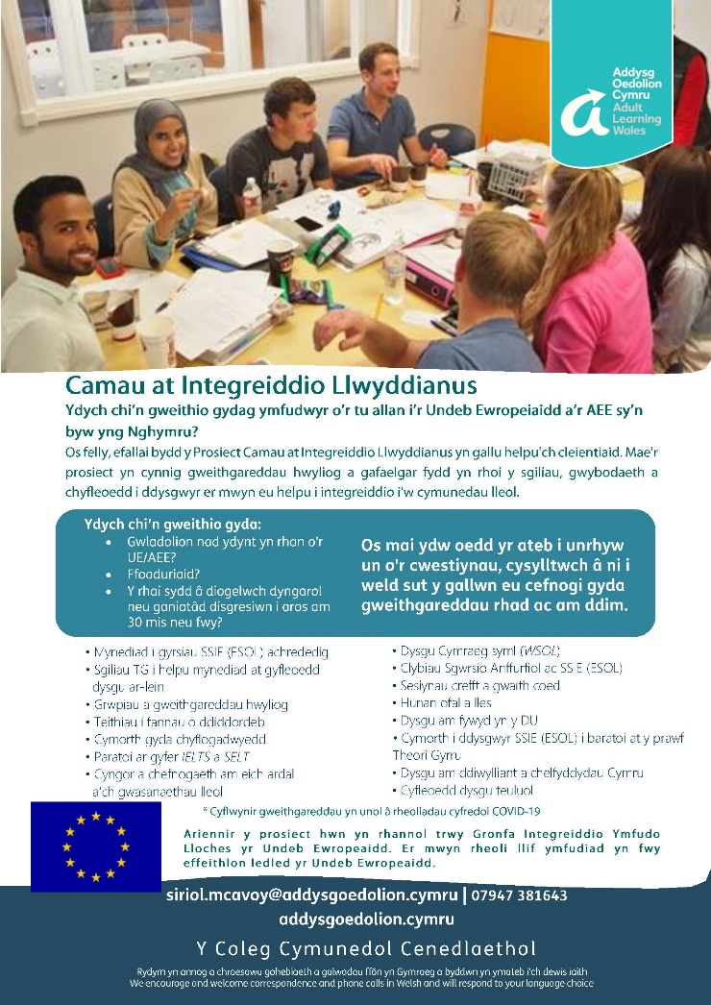
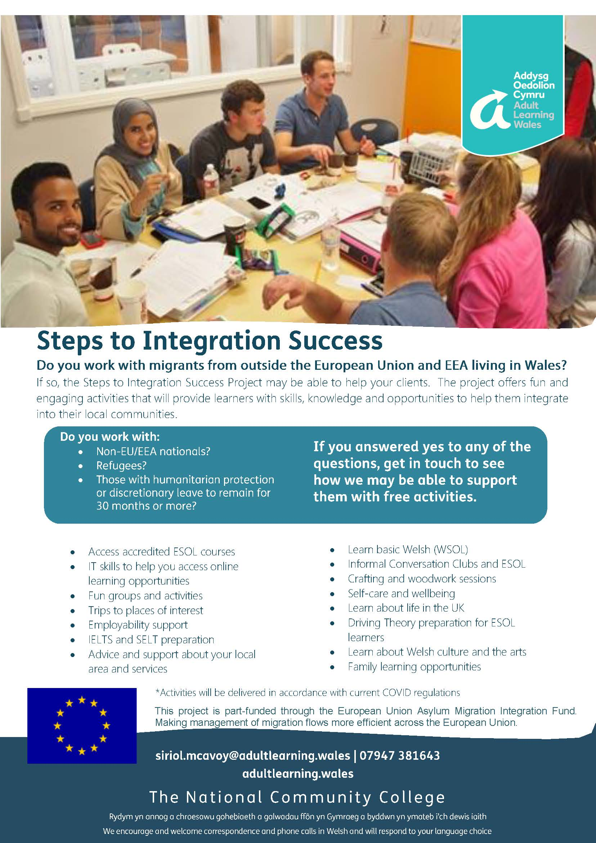
Cyflwyniad i Brosiect Camau at Integreiddio Llwyddianus
Introduction to Steps to Integration Success Project

Slide 4
Gweithgareddau Presennol a Gorffennol ac Enghreifftiau o Arloesi
Current and Past Activities and Examples of Innovation
Fy Nyddiadur Lluniau Ramadan (yn ystod Covid).
Cymraeg i Siaradwyr Ieithoedd Eraill (CSIE) wyneb yn wyneb ac ar-lein.
Cymraeg i Siaradwyr Ieithoedd Eraill (CSIE) ar leoliad.
SSIE ar gyfer Theori Gyrru.
Rhannu eich Ieithoedd.
Clybiau Sgwrsio.
Teithiau ac ymweliadau.
My Ramadan Photo Diary (during Covid).
Face-to-face and online Welsh for Speakers of other Languages (WSOL).
Welsh for Speakers of other Languages (WSOL) on location.
ESOL for Driving Theory.
Share your Languages.
Conversation Clubs.
Trips and visits.

Slide 5
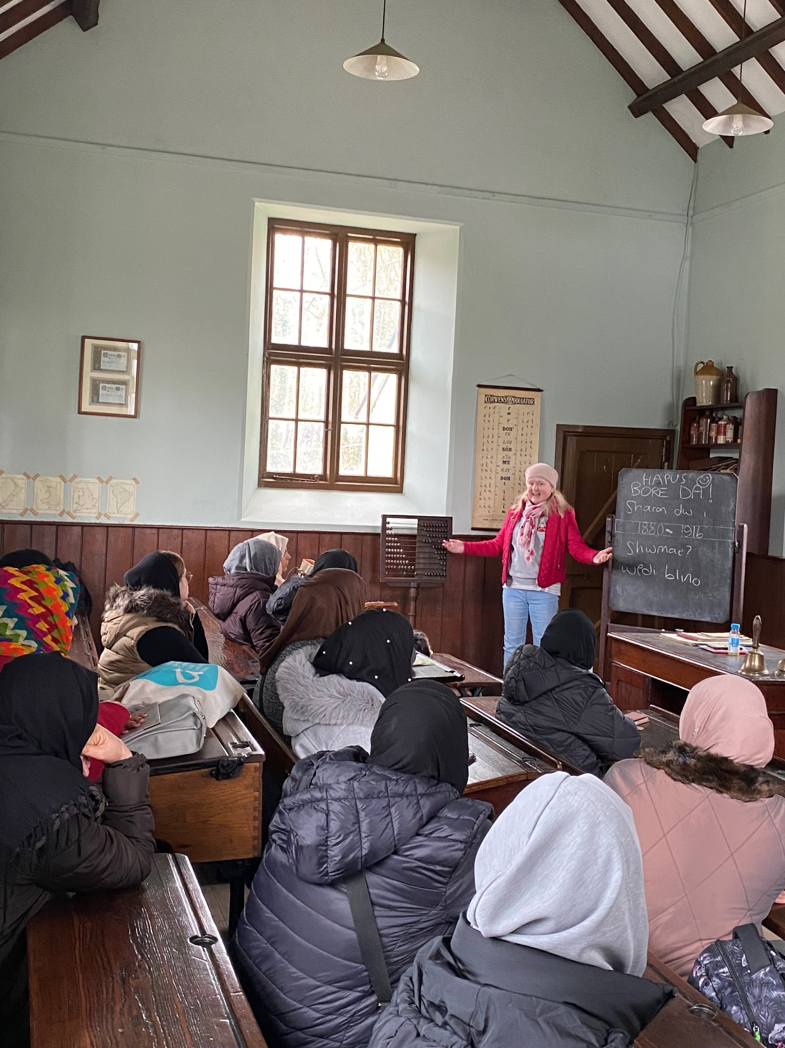
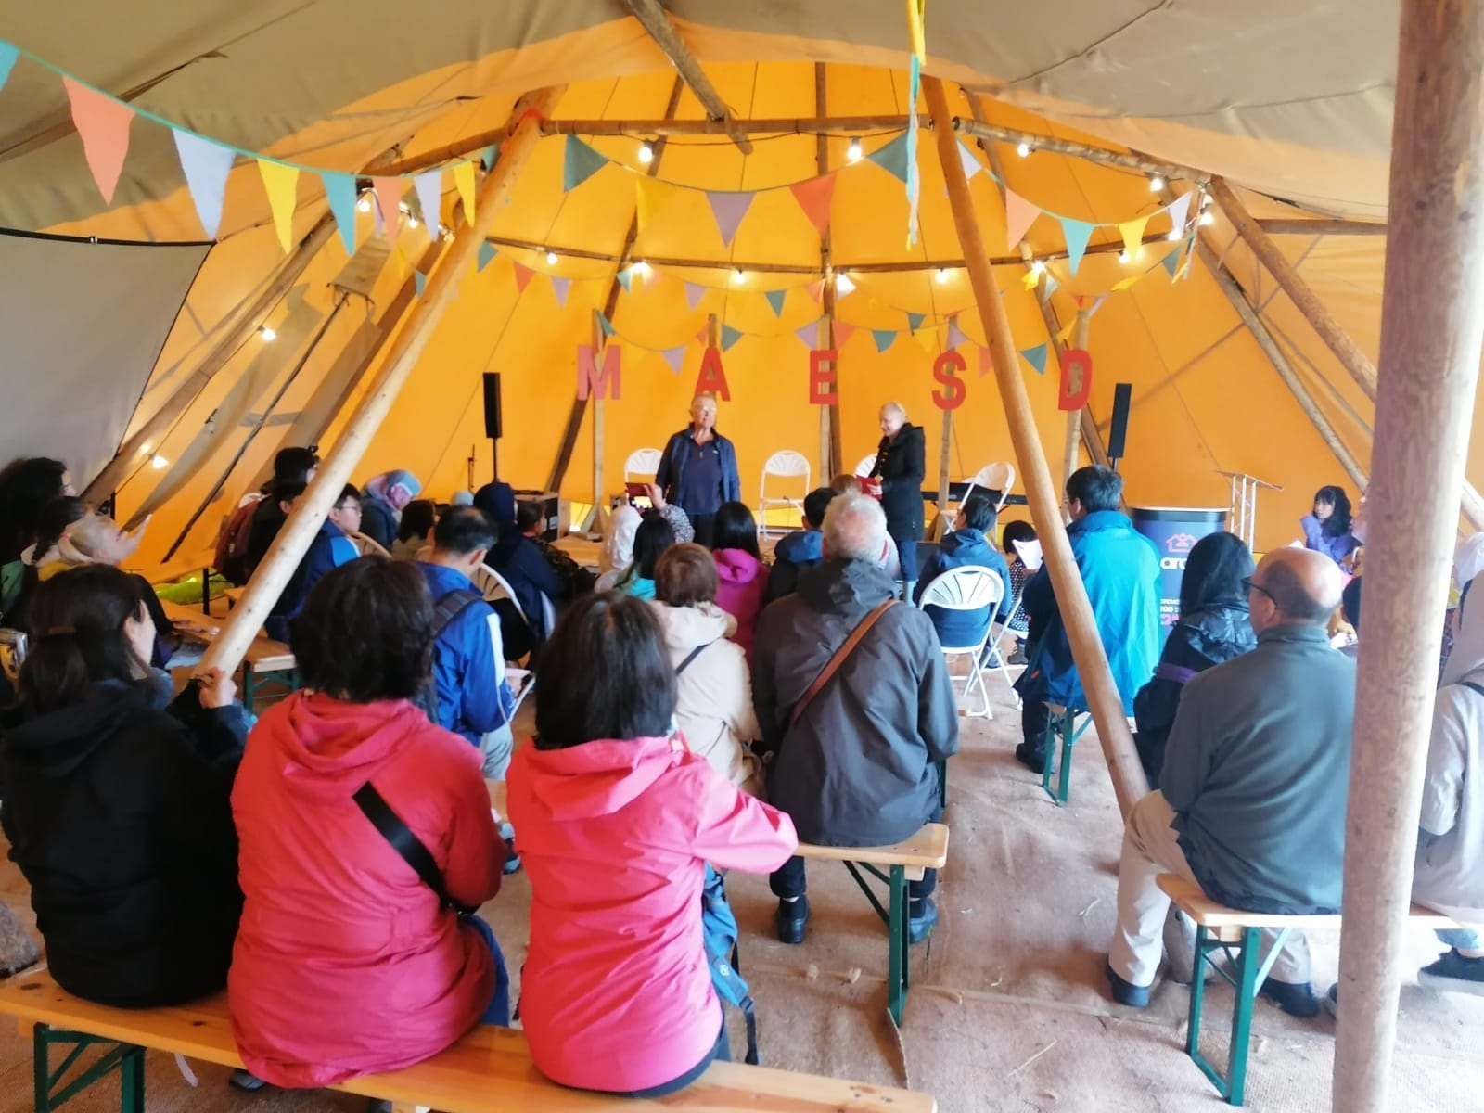
Y Prosiect ar Waith
The Project in Action
Dosbarth CSIE yn yr ysgoldy yn Sain Ffagan.
WSOL class delivered from the school house at Saint Fagans.
Dosbarth CSIE yn yr Eisteddfod.
WSOL class delivered at the Eisteddfod.

Slide 6
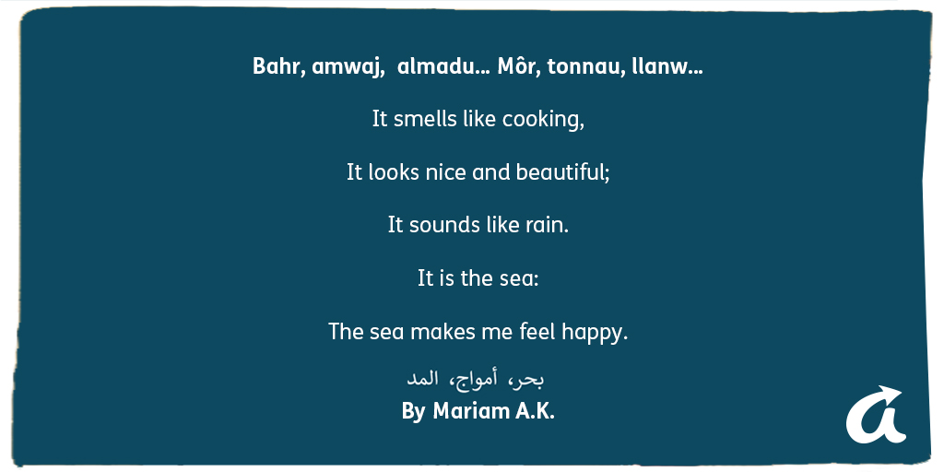
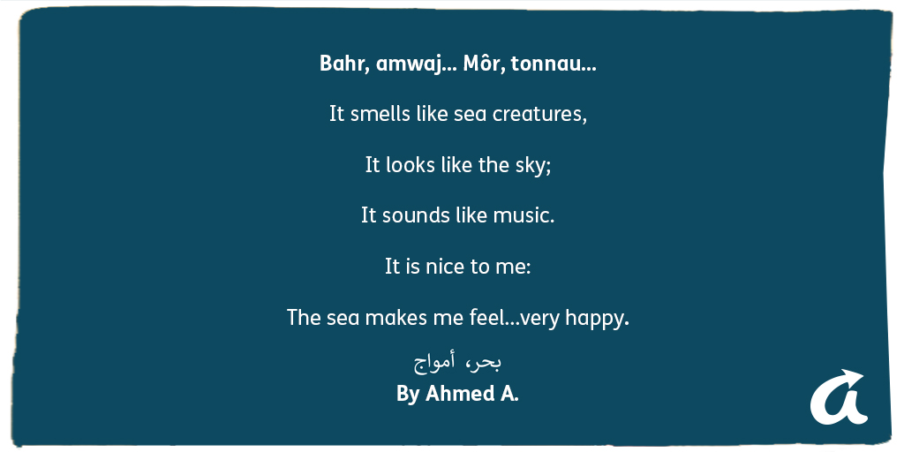
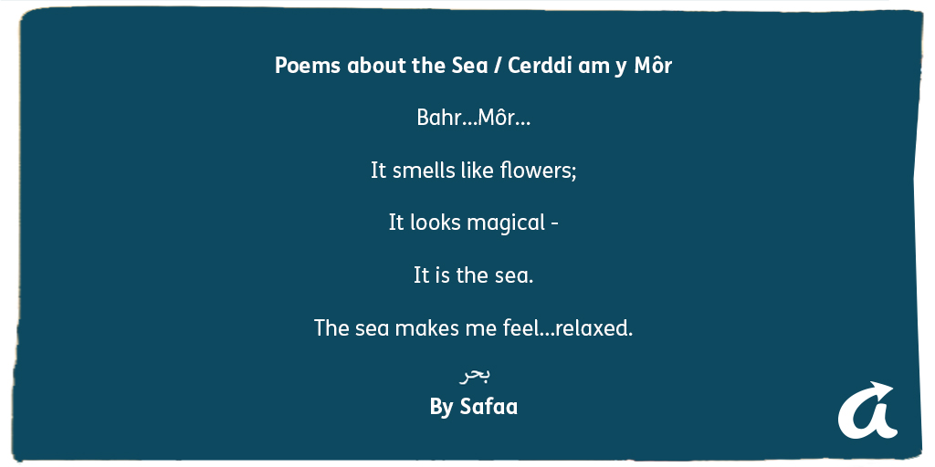
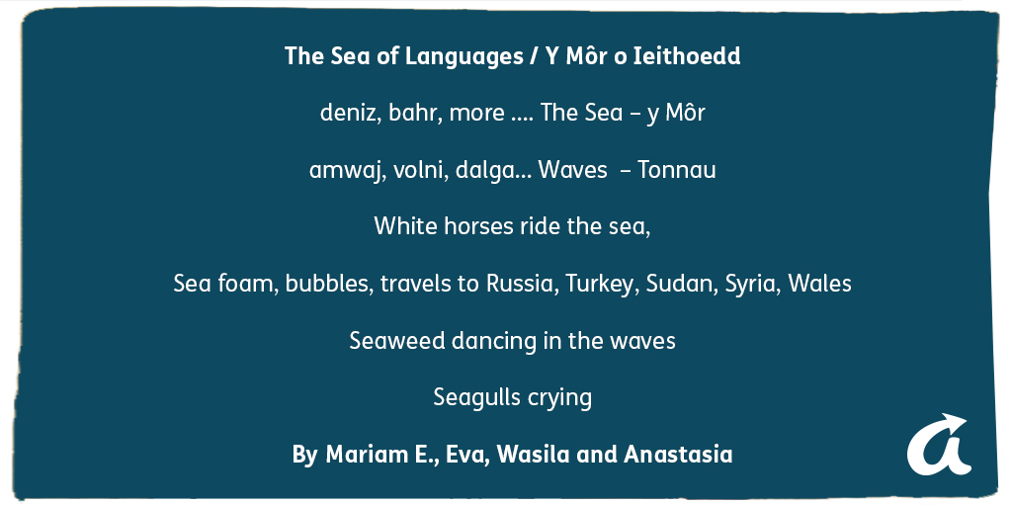
Y Prosiect ar Waith
The Project in Action
Enghreifftiau o farddoniaeth a ysgrifennwyd gan ddysgwyr yn y sesiwn Rhannu eich Ieithoedd.
Examples of poetry written by learners in the Share your Languages session.

Slide 7
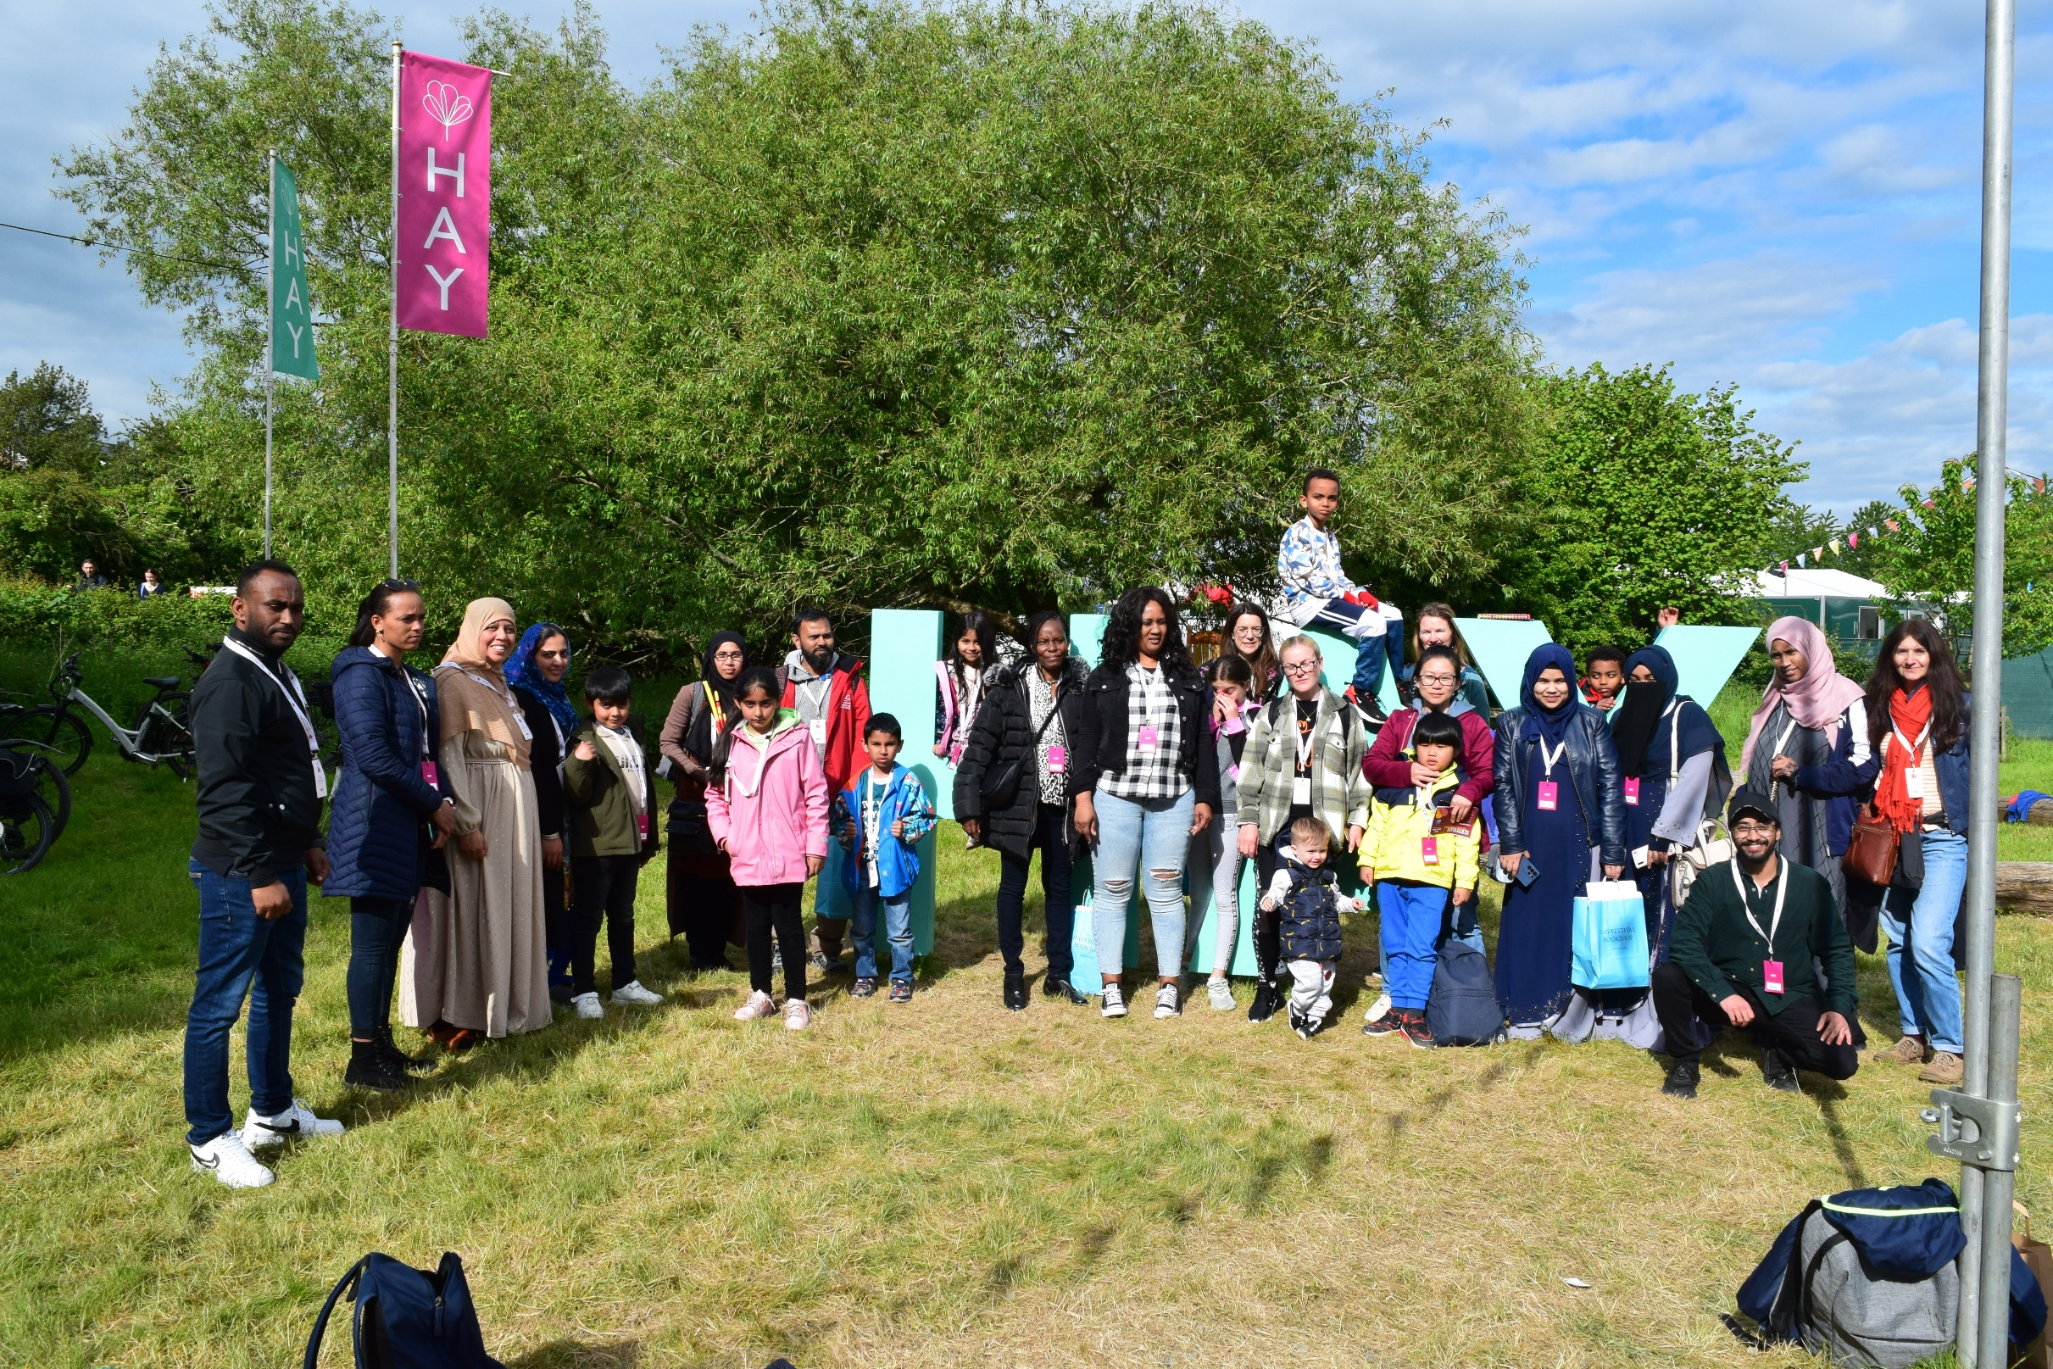
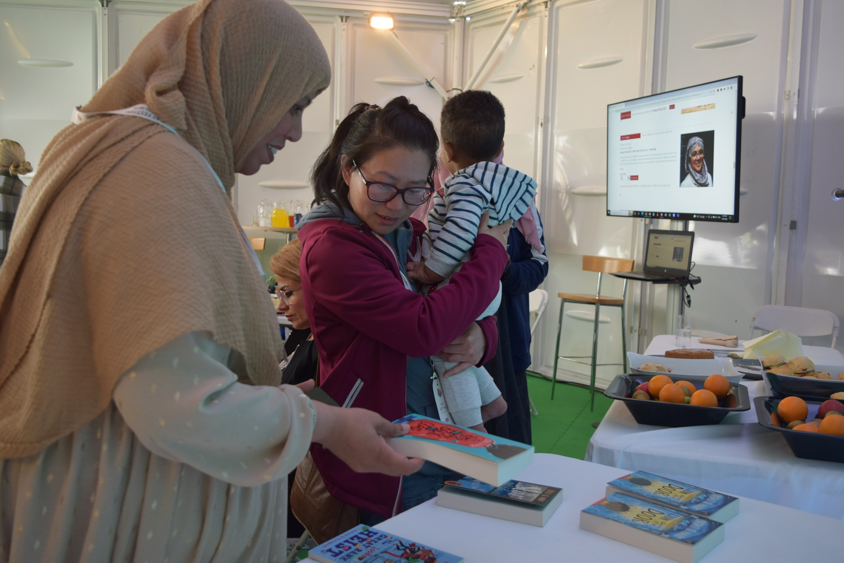
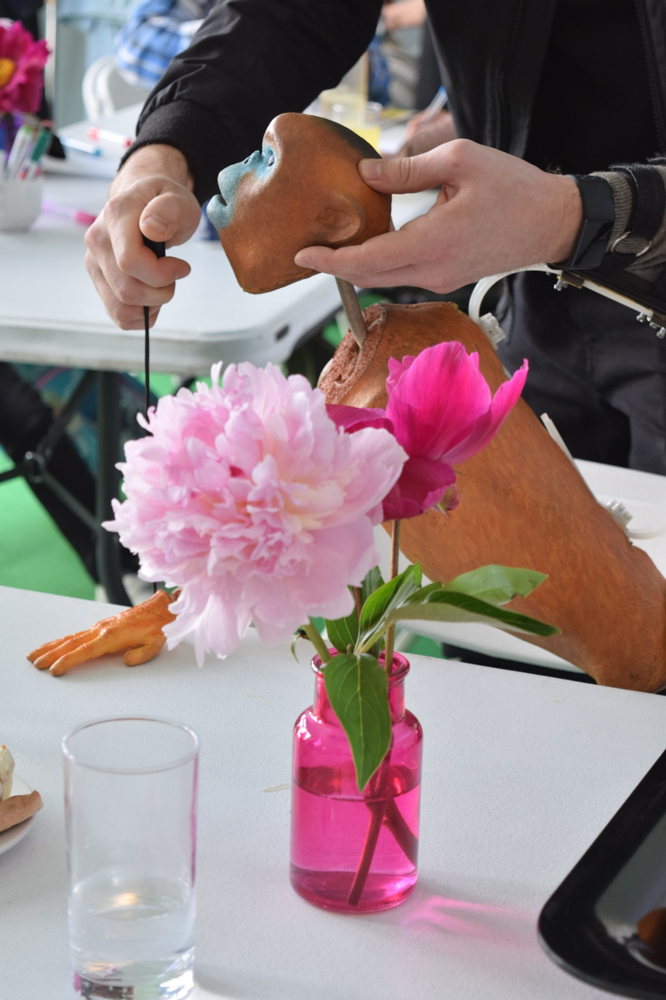

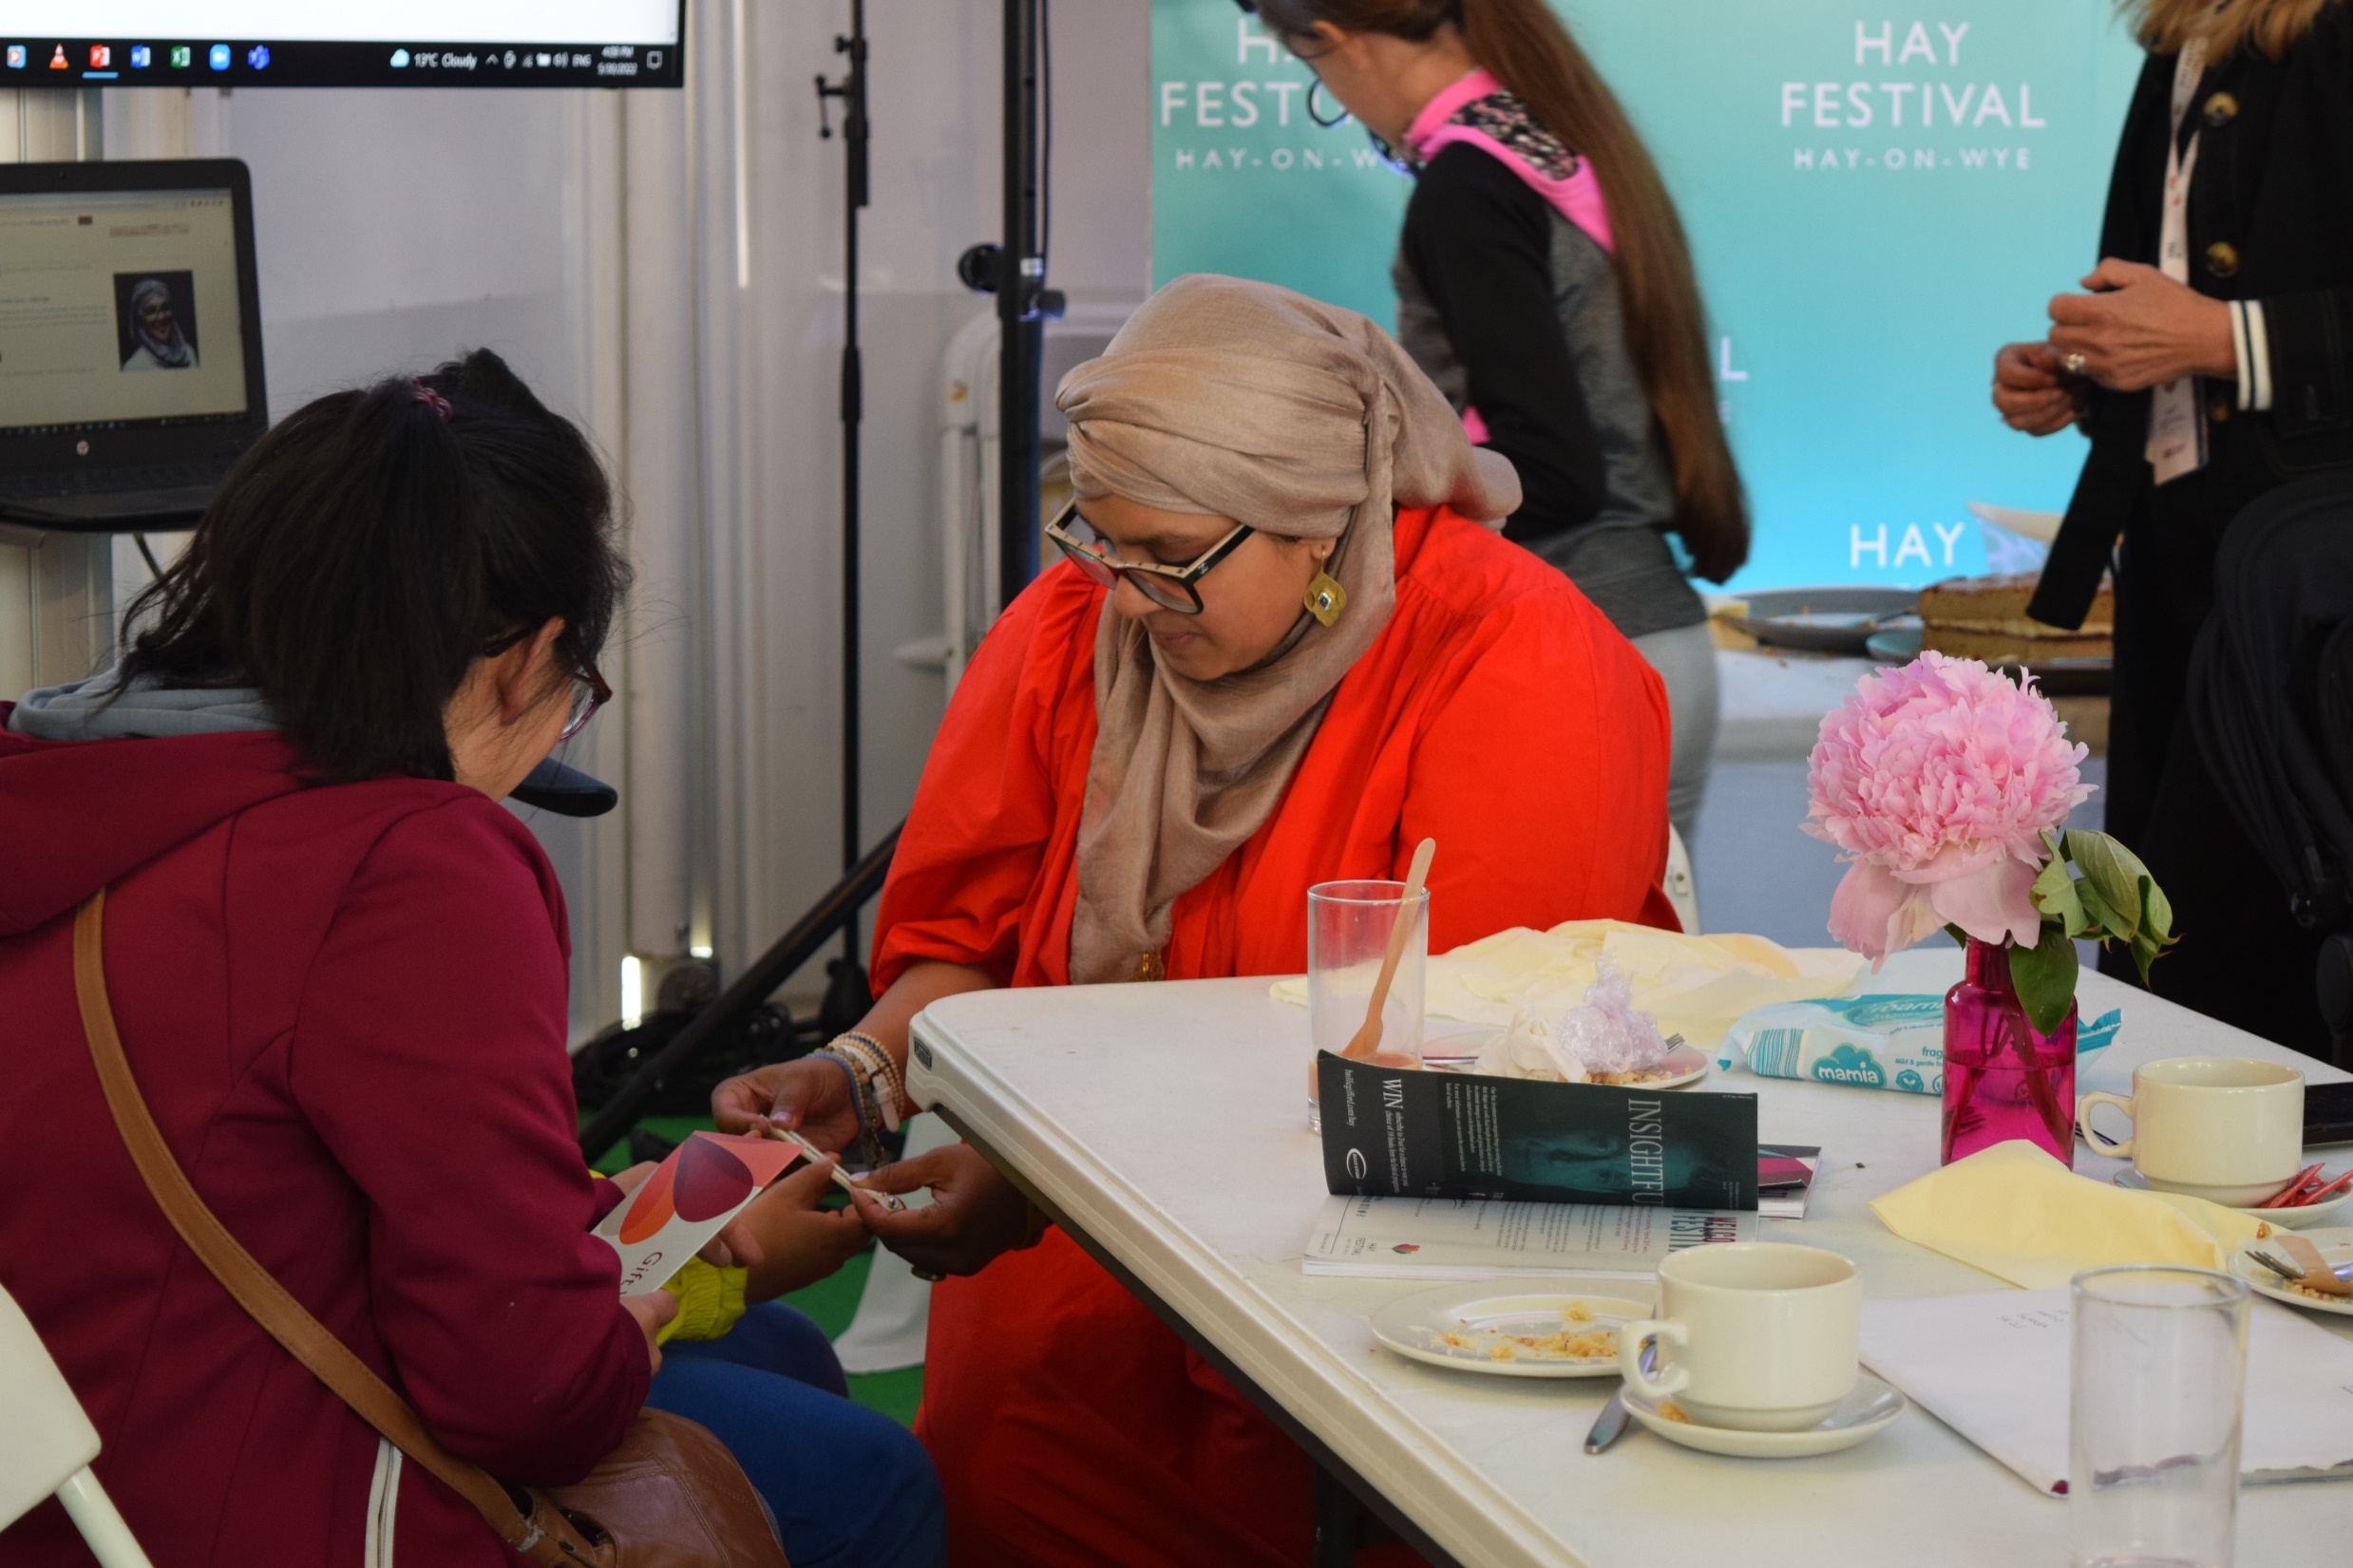
Y Prosiect ar Waith
The Project in Action
Gŵyl y Gelli 2022 | Hay Festival 2022

Slide 8
Gweithgareddau’r Dyfodol: ESOL o Gartref
Future Activities: ESOL at Home
Gwaith partneriaeth rhwng Addysg Oedolion Cymru, Partneriaeth Mewnfudo Strategol Cymru ac elusen Gulab Sorkh.
Datblygu darpariaeth ar-lein a arweinir gan ddysgwyr ar gyfer menywod o Afghanistan.
Sgwrsio anffurfiol.
Pynciau a ddewiswyd gan y menywod.
Sesiynau blasu: gwnïo, coginio, ayyb.
Cynnal cymuned ymhlith y menywod.
Taith neu ymweliad a ddewisir gan y menywod.
Gallai dilyniant gynnwys creu fforwm dysgu i fenywod yn unig.
Cyfle i ymuno â fforymau dysgwyr presennol fel Fforwm Iechyd a Lles AOC sy’n rhan o’n peilot Cwricwlwm Dinasyddion.
Partnership work between Adult Learning Wales, Wales Strategic Migration Partnership and Gulab Sorkh charity.
The development of learner led online provision for Afghan women.
Informal conversation.
Topics chosen by the women.
Taster sessions: sewing, cooking, etc.
Maintain community among the women.
A trip or visit chosen by the women.
Progression might include the creation of a women only learner forum.
Opportunities to join existing learner forums such as ALW’s Health and Wellbeing Forum that is part of our Citizens’ Curriculum pilot.

Slide 9
Manylion Cyswllt
Contact Details
Am ragor o fanylion:
For more information:
karina.scott@addysgoedolion.cymru
karina.scott@adultlearning.wales

