Slide 1


ESOL Development Day
Implications from review of Welsh Government ESOL Policy 2022

Slide 2
Research Aim
To determine how well formal ESOL provision in Wales offers adequate and timely support to learners

Slide 3
Research Questions
Whether ESOL providers are developing bespoke ESOL provision
How the progress and outcomes of ESOL learners, and their demographic characteristics, are monitored and measured over time.
The available provision to learn Welsh as well as, or instead of, English where appropriate, and the take-up of the Welsh provision.
Whether funding for ESOL provision is being used in the best possible way to achieve maximum efficiency and outcomes.
The role of the Welsh Government, local authorities, institutions, and public service partners in providing a strategic and co-ordinating lead to ensure sufficient, quality ESOL provision in Wales.
What works well in ESOL and ESOL+
What challenges/barriers and/or facilitators exist
Whether the types of ESOL provision in Wales are adequate
How well ESOL provision is offering adequate and timely support for varying immigration statuses
The impact of remote learning and digital exclusion on access to ESOL provision
The extent to which more informal, participatory forms of learning support the real-life language needs of adult forced migrants.
Access to other opportunities to develop language skills in informal and social settings

Slide 4
Methods
A rapid review of literature
Review of ESOL learning aims data on the Lifelong Learning Wales Record (LLWR)
An online survey was conducted during April and May 2022, with responses from 22 providers, 51 practitioners and 21 learners.
Four online forums attended by 24 organisations and 10 learners in June 2022
14 semi-structured interviews with key stakeholders conducted in June and July 2022
12 online/in person focus groups with teachers, managers and learners in formal and informal ESOL provision

Slide 5

Implications from the ESOL Policy review
Curriculum Development
Coordination of ESOL
ESOL Professionalism -Teacher Recruitment & Education

Slide 6

Curriculum Development
ESOL for inclusion and integration
Fast-Track options
Digital provision
ESOL plus
Materials development
Notes:
Teachers on front line/ ESOL More than an academic subject / Participatory approaches to learn and inform
Expansion of ESOL Plus
Holistic understanding of learner aspirations
Appropriate materials

Slide 7

Coordination of ESOL
Local collaboration
Digital information
National Platform
Creche facilities

Slide 8
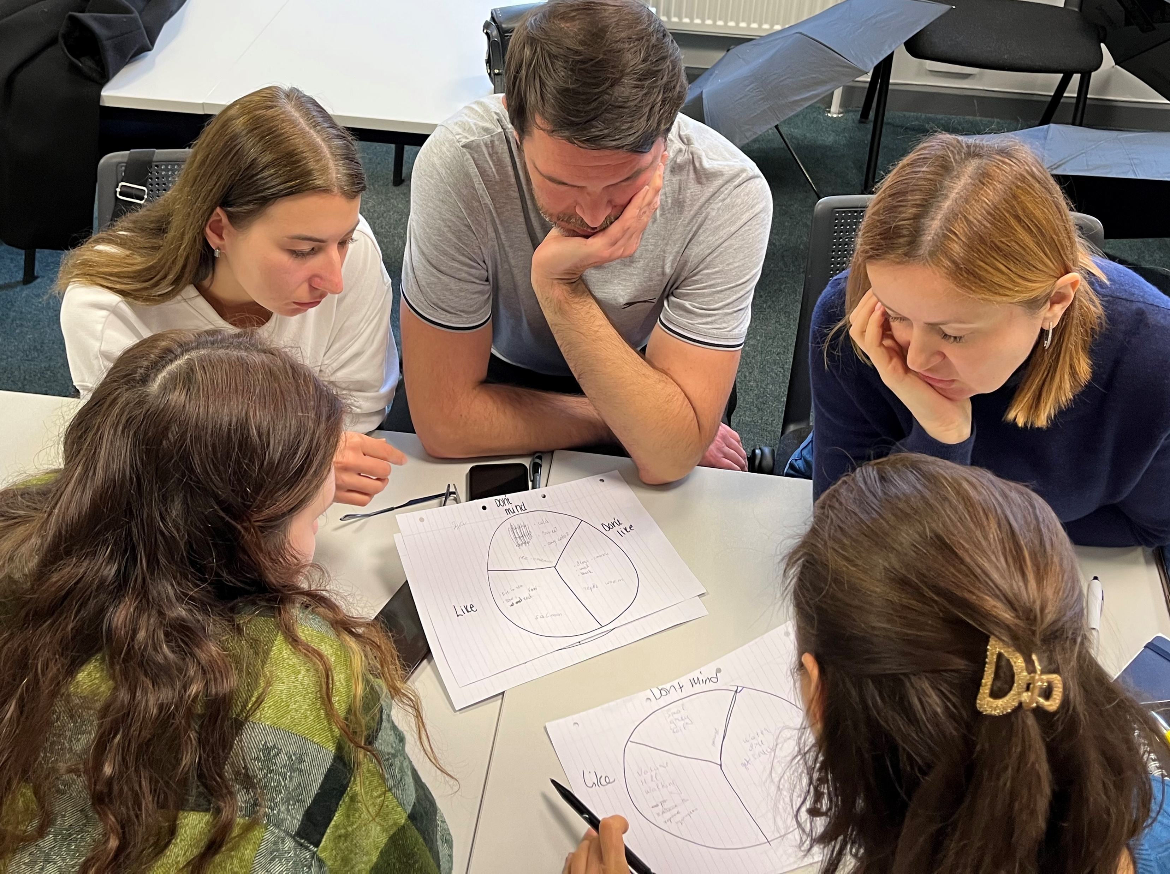
ESOL Professionalism
Qualifications
CPD Opportunities
A National Centre for ESOL
Notes:
Content of quals / NATECLA for CPD / Time off to study / etc.

