Slide 2
Our vision
At least once in the course of their education, all young people shall take part in an exchange or mobility activity to improve their language skills, their social and professional competences and thus also their prospects on the labour market.

Slide 3
Our mission
We promote and support projects and activities in the field of exchange and mobility in education and training at national and international level, both in and out of school. We network organisations and institutions in the field of exchange and mobility and bring together providers and interested users of projects and activities.

Slide 4
Our responsible body
The Swiss Foundation for the Promotion of Exchange and Mobility (SFAM) was established in March 2016 by the State Secretariat for Education, Research and Innovation (SERI), the Federal Office of Culture (FOC), the Federal Social Insurance Office (FSIO) and the Swiss Conference of Cantonal Ministers of Education (EDK).
Movetia is active since 1 January 2017.

Slide 5
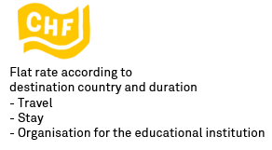
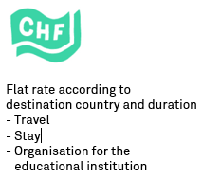

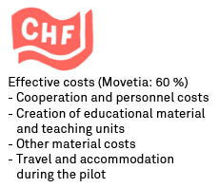
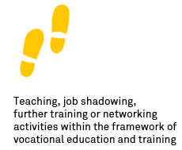

Programmes in vocational education and training
Mobilities: Individuals
Cooperation: Interinstitutional cooperation
VET institutions are eligible to apply, not individuals:
Vocational schools, professional associations, organisations of the world of work,
cantons, training companies
National Programme
CH Programme to Erasmus+
CH-Programme to Erasmus+
International Programme
Learner mobility*
* incl. Apprenticeship graduates
Teaching staff mobility
Institutional educational cooperation
Notes:
Alle Programme haben Komplementarität zu beruflicher Grundbildung und können die gezielte Förderung
transversaler Kompetenzen unterstützen.

Slide 6
Target groups and activities in VET
Target group 1: VET learners, VET graduates
Activities: VET traineeship (work placement) or thematic project work from 5 to max. 365 days (excl. travel days)
Target group 2: VET professionals, teachers etc.
Activities: Exchange on education and training issues from 2 to max. 60 days (excl. travel days)
Teaching observation (job shadowing)
Teaching activities
Networking
Structured further training: Participation in courses, seminars, conferences

Slide 7
Swiss Programme for Adult Education
Adult education is defined as non-formal and non-vocational training for adults. Further trainings leading to federally recognised qualifications are defined under VET, school education or higher education.
2 project formats: Mobility- and Cooperation-Projects
Mobilities enable trainers, directors and advisors of adult education institutions from Switzerland to participate in structured training (courses, conferences), job shadowing and teaching activities abroad. Conversely, adult education staff from abroad can be invited to Switzerland.

Slide 8
Swiss Programme for Adult Education
Cooperation projects allow (educational) institutions from at least four European countries to explore a relevant topic in depth over a longer period and through several meetings, and if applicable to develop joint solution approaches and tools. The aim is to promote quality and innovation in adult education in Europe.
Preparatory visits
Staff from schools or other organisations working in school education receive support to visit future partner organisations before submitting a project, establish contacts for joint projects and prepare projects with partners.

Slide 9
Swiss Programme for Adult Education Example
Financial services are becoming more complex and increasingly digital. Teaching basic financial skills is an important task in further education and debt prevention. In the Managing Money project, adult education institutions from eight countries have therefore jointly developed a curriculum and various teaching and learning resources - not least the Managing Money app - for dealing with money.

Slide 10
Swiss Programme for Adult Education Example
The Swiss Association for Continuing Education SVEB was a Swiss partner in the European cooperation project. The needs analysis in the first project phase showed a great diversity and strong fragmentation of the actors in debt prevention in Switzerland. Providers of further education have so far hardly dealt with the topic and have hardly used synergies with the counselling centres. Thanks to the needs analysis and a stakeholder workshop in Zurich, the Managing Money project allowed SVEB to expand its own network. The project contributed significantly to the networking of various other actors in debt prevention and counselling in Switzerland. Results are: invitations to conferences, exchange of teaching materials and resources and mutual visits to events. The curriculum and teaching resources developed in the European project, as well as the guide for teachers, are used by course leaders in SVEB. Some of the institutions involved in the project are already partners in a new European cooperation project of the SVEB.

Slide 11







Your contact at Movetia
José Oberson
Head of division
jose.oberson@movetia.ch
+ 41 32 462 00
Yvonne Jänchen
Programme coordinator
European cooperation programmes
yvonne.jaenchen@movetia.ch
+ 41 32 462 00 68
Charlotte-Sophie Ramseier
Project manager
Adult Education
charlotte-sophie.ramseier@movetia.ch
+ 41 32 462 00 70
Arnaud Clément
Project manager
International Programme
arnaud.clement@movetia.ch
+ 41 32 462 00 82
Zaira Orschel
Programme coordinator European mobilities
zaira.oschel@movetia.ch
+ 41 32 462 00 71
Zhila Ahmadi
Administration
Europa Mobilität
zhila.ahmadi@movetia.ch
+ 41 32 462 00 74

