Slide 1
CPCA WiDER OUCOMES FRAMEWORK
Jaki Bradley
Wednesday 13th August 2025

Slide 2
the CPCA context
Devolved Adult Skills budget – approx. £12 million
Adult Skills Fund – 79% - approx. £8.6m
Tailored Learning (Community Learning) – 21% - approx. £2.3m
8 Grant funded providers – 5 FE colleges, 2 local authority providers, WEA
3 Independent Training Providers

Slide 3
CPCA wider outcomes framework

Slide 4
the CPCA wider outcomes framework
Introduces a consistent, evidence-based model to collect, analyse, report and use evidence on the outcomes that adults experience in different areas of life as a result of their learning.
Commissioned by Cambridgeshire & Peterborough Combined Authority (CPCA), the devolved combined authority which supports adult learning in the region through the Adult Skills Fund (ASF).
Will provide insights into the difference that ASF-funded learning makes to the lives of residents in the CPCA area.
Co-designed and co-owned by CPCA and its commissioned providers of adult learning.
Piloted with some ASF Tailored Learning courses in the 2024/25 academic year and is being rolled out across provision for 2025/26.

Slide 5


The wider outcomes of adult learning
A well-researched area over the last twenty years
Learning has a positive impact on a range of aspects of adults’ lives
…however, funders prioritise labour market measurements (job outcomes, productivity etc…)
Notes:
The following few slides just demonstrate that this area has been well researched over many years – many of you will be familiar with this research and some of you will have been involved I’m sure.

Slide 6


Overlapping benefits of adult learning
Third Global Report on Adult Learning and Education (2016)
“…no matter where in the world they live, adult learning and education helps people become healthier, to improve their economic prospects and to be more informed and active citizens.”

Slide 7


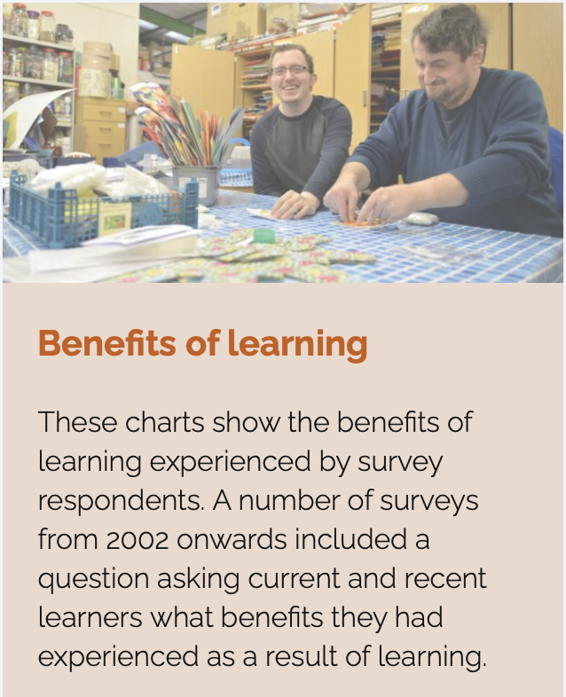

Underpinning research
Centre for the Wider Benefits of Lifelong Learning (199-2007)
Longitudinal household surveys
National adult learning surveys
International surveys

Slide 8
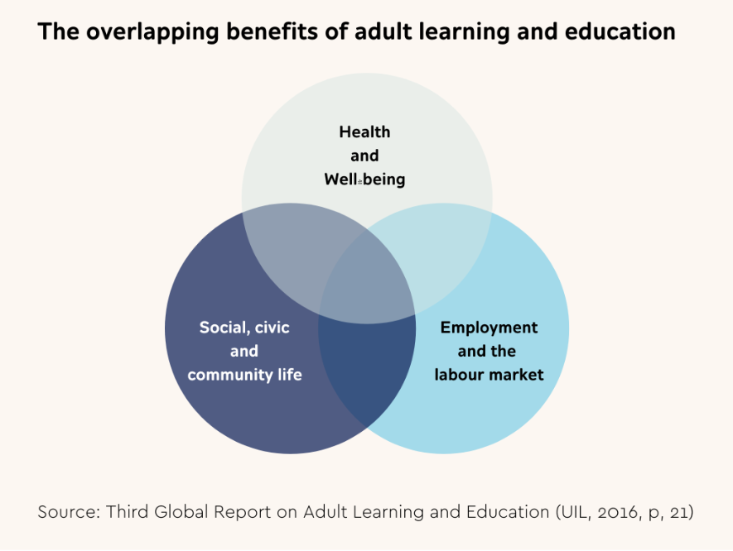
The wider benefits of learning
Notes:
In developing the framework we felt that the overlapping benefits of learning and the domains of health, work and community reflected the the policy focus of the CPCA and strategic intent of ASF.

Slide 9
The cpca wider outcomes framework
The Framework consists of five sections:
Section 1: Introduction, design process and principles
Section 2: CPCA strategic intent
Section 3: CPCA model—logic chain, indicators, and evidence sources
Section 4: Data collection, collation, analysis and reporting
Section 5: Timescales and lead responsibilities
Notes:
Developing the framework

Slide 10
Design principles
    Joint ownership and responsibility
    Commissioners and providers work in partnership to implement the Framework
Evidence-led approach
The Framework is based on underpinning theory and effective practice derived from national and international research.
Valid and reliable methods of evidence-gathering will be applied in a consistent manner.
The Framework will triangulate data from a range of sources to provide a broad view of the outcomes of adult learning.
Baseline data on the outcomes of learning will be collected to enable benchmarking and inform judgements about the performance of CPCA ASF provision over time and in relation to the picture nationally and other devolved areas.

Slide 11
Design principles (cont)
Continuous review and development
The Framework will be continually reviewed with stakeholders as circumstances change, to ensure that it remains fit for purpose. I
Proportionate
The Framework will not impose an excessive burden on providers and its application will be proportionate to the level of investment made.
Transparent
Findings on the outcomes of adult learning will be published annually and reviewed by CPCA’s Employment and Skills Committee.
Notes:
You won’t know this is happening – CPCA will do the analysis using the data you submit anyway.
Explain how it has been developed by providers on IWG and piloted by TL providers. Stress that the approach is co-designed and provider-led. Summarise findings from the pilot – different approaches used etc.
Give out questions and learner information sheet.

Slide 12
Cpca strategic intent (1)
ASF will contribute to addressing a range of policy challenges identified in the region.
Geographical disparities exist in relation to residents’ skills, employment, income and health, with Fenland and Peterborough experiencing clusters of multiple deprivation.
Health inequalities are apparent and an increase in economic inactivity rates linked to poor mental and physical health. Healthy life expectancy in Fenland and Peterborough are below the national average.
CPCA policymakers recognise the role that ASF-funded learning can play in tackling inequalities and contributing to delivering strategic objectives across a other policy areas.

Slide 13
Cpca strategic intent (2)
CPCA’s Funding Rules for the devolved ASF for 2024/25 state:
“The purpose of the ASF is to support adult learners to gain skills which will lead them to meaningful, sustained, and relevant employment, or enable them to progress to further learning which will deliver that outcome.”
“Within the ASF, further provision for learning is available that supports wider outcomes such as to improve health and wellbeing, equip parents/carers to support their child’s learning, and develop stronger communities (Tailored Learning/Community Learning).”

Slide 14
Adult skills fund aims 2025-26
1. Provision that reduces regional skills shortages
ASF must be used to deliver provision that aims to reduce regional skills shortages in foundation and priority sectors. Provision can also be delivered that seeks to address national skills shortages.
2. Delivery of the four legal entitlements
ASF must be used to deliver the ‘4 Legal Entitlements’. These entitlements are set out in the Apprenticeships, Skills and Children Learning Act 2009, and enable eligible learners to be fully funded for specific English, Maths, ESOL and Digital Skills learning aims.
3. Provision that develops transferable skills
ASF must be used to deliver skills to develop the individual’s employability, confidence and self-esteem, health and mental wellbeing, financial awareness, independent living skills, and broader awareness of sustainability and carbon literacy.
Notes:
Aim 1 Success measure: The Authority will monitor the breadth and depth of skills provision across these sectors and the success rates (achievement and retention) of provision. These will be benchmarked to the National Rates to see how well providers perform regionally. The Authority expects providers to offer skills provision at entry level, including level three.
Aim2 Success measure - Success measure: The Authority will monitor delivery success rates (achievement and retention), which will be benchmarked against National Rates to see how well providers are performing regionally
Aim 3 Success measure - Success measures: The Authority will monitor delivery success rates (achievement and retention) where provision is regulated. These rates will be benchmarked against National Rates to see how well providers are performing regionally. The Authority will also use the new Wider Outcomes Framework to measure the distance travelled for each learner participating in this type of provision.

Slide 15
The cpca wider outcomes framework
The framework is based on a logic chain model which shows how change happens
Inputs | Activities | Outputs | Outcomes | Benefits | Impact
What financial resource will we commit in the region? | What learning will we provide to achieve change? | What do we expect from our provision? | What are the learning and progression outcomes learners will get? | What are the benefits to learners’ health, working life, and community participation? | How will the CPCA region and wider community benefit?

Slide 16
How does the framework define the ‘outcomes of learning?’
The changes that are experienced by individuals as a consequence of taking part in learning funded through the ASF.
Distinct from, but can contribute to, the longer term economic and social changes, or impact.
Notes:
These are distinct from, but can contribute to, the longer term economic and social changes, or impact, that CPCA aims to achieve for the region.

Slide 17
Outcomes to impact
Outcomes are the direct results of the intervention for individuals who are involved. They happen in the short to medium term
Impact is the longer term, significant and measurable difference that the intervention makes for wider society.
Individuals are better able to manage their physical and mental health
Impact
Outcomes
Reduced health inequalities
Lower levels of economic inactivity
Notes:
Understanding this relationship between outcomes and impact is important, because it describes how the commissioning of provision and delivery of front line services to residents is intended, over time, to secure strategic policy objectives.
Capturing the outcomes of learning requires data that derives directly from learners’ subjective experience of how learning has made a difference to their lives. The commissioning decisions made by CPCA policymakers, and adult learning providers’ approaches to delivery, are critical for creating the conditions in which outcomes can be realised, but ultimately they are ‘owned by’ the learner.

Slide 18
There are different types of outcomes of adult learning
Learning outcomes
The skills, knowledge and understanding gained on the course.
Progression outcomes
Changes in a learner’s outlook, attitudes and approach to self, learning and life.
Wider outcomes
Changes experienced by learners in relation to different areas of life:
Measured through the RARPA process implemented at course level.
Provide a basis for further change and development.
Benefits often grouped into three broad categories of
Health,
Work
Community
Notes:
The Framework divides the outcomes of learning into two categories:
Progression outcomes: changes in general personal attributes, such as confidence to learn, personal resilience and ability to speak out.
Wider benefits: changes in attitudes and behaviours related to specific areas of life.
The wider benefits of learning are further categorised into the following three domains:
Health
Health and wellbeing is a broad concept, embracing our bodies, our minds, our feelings about ourselves and where we live, as well as our ability to help ourselves and others. Outcomes often address the ‘causes of the causes’ of ill-health and poor well-being.
Work ‘Work’, in this context, is a term that encompasses employment, self-employment, and volunteering. Work benefits include levels of remuneration, work-life balance, the motivation to start a new business, gain new employment, or progress at work.
Communities Community is a broad and inclusive term that encompasses: place, interest, identity and need. Increasingly communities are global, virtual or involve a combination of physical engagement and online interaction. Community also relates to family life. How individuals engage with their communities is a key outcome of adult learning.

Slide 19
The CPCA wider outcomes framework
Progression outcomes | Wider outcomes / benefits
 | Health | Work | Communities
1. Engaging and/or building confidence 2. Preparation for further learning 4. Improving Essential Skills (English, maths, ESOL, digital) | 6. Health and wellbeing | 3. Preparation for employment | 5. Equipping parents and carers to support children’s learning 7. Developing stronger communities
The seven purposes of learning as defined by the DfE mapped to the wider outcomes framework.
Notes:
In 2024-25 the pilot year – we asked providers to map their Tailored Learning planning the the 7 purposes of learning which is what they are required to do by the DfE. We mapped the purposes to the outcomes framework.

Slide 20
The cpca wider outcomes framework
Progression outcome | Wider outcomes / benefits
 | Health | Work | Communities
Outcome area 1: Increased confidence Outcome area 2: Improved skills for progressing to further learning. Outcome area 4: Improved essential skills Outcome area 10: Improved Skills for Independent Living. | Outcome area 6: Improved physical health. Outcome area 7: Improved mental health and well being | Outcome area 3: Improved skills for work | Outcome area 5: Improved ability to support a child’s learning. Outcome area 8: Improved skills to participate in community life Outcome area 9: Increased understanding of democratic values
The ten outcomes of learning as defined by the DfE mapped to the wider outcomes framework.
Notes:
Only one outcome is collected in the ILR which doesn’t reflect that most people experience more than one outcome of learning as per the overlapping benefits.
For 2025-26 we have asked providers to plan their curriculum against the outcomes rather than the purposes. The outcomes will be collected as part of the ILR data and this will help us to further develop our commissioning, understand the offer both regionally and in sub regions and to inform future commissioning decisions. The framework is helping us to move towards commissioning against outcomes.

Slide 21
Types of evidence
The evidence base set out in the Framework draws on two sources of data:
1. ‘Naturally occurring data’ which providers are already required to collect and report to CPCA.
2. Evidence collected through a new set of learner questions coordinated by CPCA with a specific focus on the wider benefits of learning in four domains: progression, health, work and communities.
Notes:
You won’t know this is happening – CPCA will do the analysis using the data you submit anyway.
Explain how it has been developed by providers on IWG and piloted by TL providers. Stress that the approach is co-designed and provider-led. Summarise findings from the pilot – different approaches used etc.
Give out questions and learner information sheet.

Slide 22
Types of evidence
Inputs | Activities | Outputs | Outcomes | Benefits | Impact
Total spend (inc. co-investment) Spend per resident Spend per participant Spend per district Spend per delivery strand | Engagement Learner support General community learning Targeted community learning | Enrolment rate Completion rate Achievement rate Satisfaction rate Qualifcations / credentials/digital badges RARPA rate ILP completed | Confidence Progression Employment Essential skills Parenting Physical health Mental health Community participation Democratic values Independent living | Health and wellbeing Employment and labour market Civic and community | Benchmarks against regional indicators in health, working life, and community National benchmarks

Slide 23
Benefits statements
Skills and learning
I am more motivated to learn new things
I have greater self-confidence
I have more influence over my life
I have better communication skills
I have better number skills
I have better digital online skills.
Health and wellbeing
I am better able to look after my health / wellbeing
I am more physically active
I am less anxious / stressed
I feel happier / more content
Work
I am more positive about starting paid work or volunteering
I am more prepared for getting a better job
I am more prepared for starting my own business
I am more satisfied at work
Communities
I have greater satisfaction with my social life
I feel more part of my local community
I have a better relationship with my children / family
I am more involved in my children’s education
I am more likely to take part in voluntary activity in future
I am more aware of how my actions impact on the environment
Notes:
We worked with providers, learners and stakeholders to test questions that made sense to people. There were several iterations and these are the final agreed survey questions

Slide 24
Pilot - Agreed approach
  Providers to administer the questions as part of their end-of-course review and feedback processes.
  Data to be returned via spreadsheet created and administered by CPCA.
  Learner information sheet disseminated to support providers and practitioners with engaging learners in responding to the questions.
  Data collation and analysis to be undertaken by CPCA, including matching results to ILR.
  Each provider to receive a report of their own collated and analysed data.

Slide 25
Pilot – basic data
Row Labels | Learner Responses | Distinct Learner Responses | Distinct Learner Responses in %
Answer 1a - I am more motivated to learn new things | 280 | 240 | 60.91%
Answer 1b - I have greater self-confidence | 110 | 92 | 23.35%
Answer 1c - I have more influence over my life | 98 | 90 | 22.84%
Answer 1d - I have better communication skills | 188 | 164 | 41.62%
Answer 1e - I have better number skills | 37 | 36 | 9.14%
Answer 1f - I have better digital online skills | 27 | 26 | 6.60%
Answer 2a - I am better able to look after my health / wellbeing | 56 | 47 | 11.93%
Answer 2b - I am more physically active | 47 | 41 | 10.41%
Answer 2c - I am less anxious / stressed | 87 | 76 | 19.29%
Answer 2d - I feel happier / more content | 122 | 102 | 25.89%
Answer 3a - I am more positive about starting paid work or volunteering | 97 | 84 | 21.32%
Answer 3b - I am more prepared for getting a better job | 42 | 42 | 10.66%
Answer 3c - I am more prepared for starting my own business | 9 | 9 | 2.28%
Answer 3d - I am more satisfied at work | 42 | 40 | 10.15%
Answer 4a - I have greater satisfaction with my social life | 71 | 62 | 15.74%
Answer 4b - I feel more part of my local community | 91 | 81 | 20.56%
Answer 4c - I have a better relationship with my children / family | 66 | 64 | 16.24%
Answer 4d - I am more involved in my children’s education | 59 | 55 | 13.96%
Answer 4e - I am more likely to take part in voluntary activity in future | 57 | 51 | 12.94%
Answer 4f - I am more aware of how my actions impact on the environment | 32 | 27 | 6.85%
No Answer/Response | 86 | 77 | 19.54%
Grand Total | 1704 | 394 | 100.00%
Notes:
This is the first set of data from the survey. This will be matched to the ILR where demographic data and other information is collected so that we can start to be more sophisticated in our analysis of the benefits of learning. This process is now underway although we won’t be able to produce the final report until Jan/Feb as the final ILR return will be in October and must be validated before we use the data.

Slide 26
Pilot – final report
Final report will have the following format.
Introduction
Background: CPCA WOF model, its components, and agreed approach
Collection: what data was collected, any issues experienced
Collation: how the provider data sets were combined, any issues
Analysis
ILR data on CPCA Tailored Learning
Learner Survey data from providers
Case studies
Combining the data within the CPCA WOF
Conclusions and recommendations
What have we learned about collection and collation processes
What the combined data tells us in the three domains of health, work and communities
What are the next steps?
Notes:
Will be happy to share the report and the framework with colleagues. Any questions?

Slide 27
Contact details
Jaki.Bradley@cambridgeshirepeterborough-ca.gov.uk

Slide 28
Thank you for your time today

