Slide 1


Thursday 21 May 2026 | 11am – 1pm

Slide 2
Stephen Evans
Chief Executive, Learning and Work Institute (Chair)

Slide 3
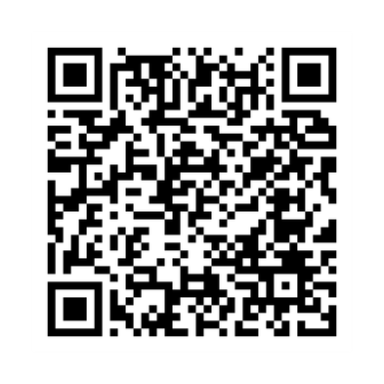

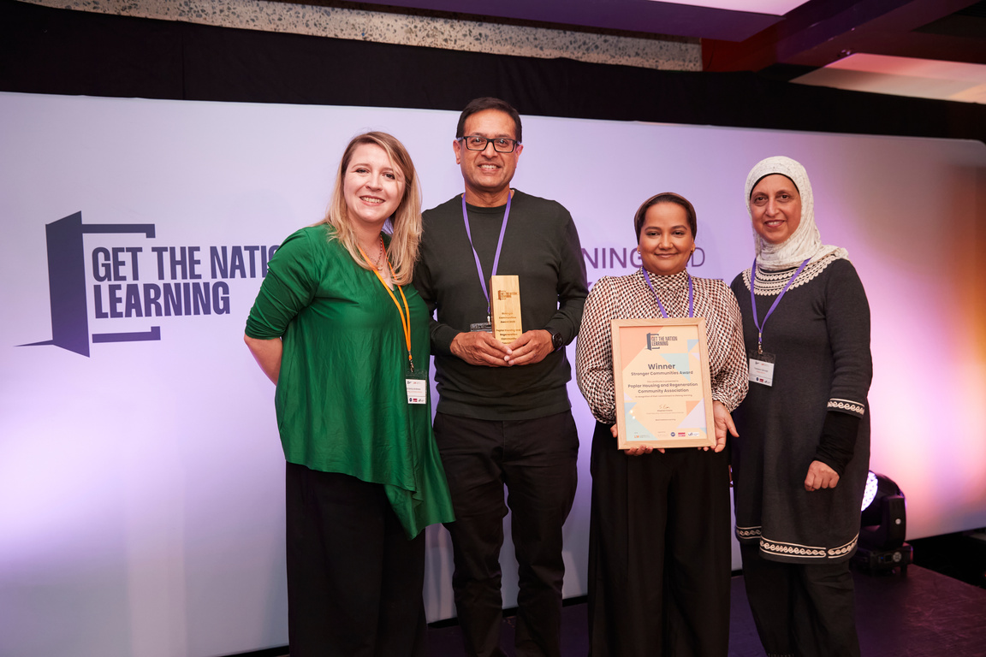



Submit a nomination for the Get the Nation Learning Awards 2026 by 4 June.
Learning providers, employers, community organisations, local and regional governments, and individual learners all are eligible.

Slide 4
Learner panel:
Najim
Jacqui
Mark
Badria
From WM College

Slide 5
Isobel Hunter MBE
Chief Executive
Libraries Connected

Slide 6
Professor Uta Papen
Professor of Literacy Studies
Lancaster University

Slide 7


Skills for Life or Skills for Work?
ALLN policy and practice – a critical examination
Uta Papen, Literacy Research Centre
Lancaster University

Slide 8


My interest
Critical analysis of adult literacy, numeracy and ESOL policy and practice (essential skills) (England, Scotland, Australia)
Current focus and priorities
Who is reached and might benefit? What is missing and who are we missing? Rethinking adult literacy policy
Policy analysis + 30 interviews with practitioners, managers, policy researcher and advocates

Slide 9


Current policy: core goals
Employability and economic development,
work-related skills, qualifications
Functional Skills
Significant funding cuts and decline in participation
(60% since 2010). Funding reduced by £1 billion since 2010 (LWI )
Belief in accredited courses and learning assessed by exams.
Individualistic and ‘moving on’ discourse.
Notes:
The (internalized) deficit view and the focus on the individual as responsible for their (lack of) learning that underpins
current policy
Individualistic: developing required skills considered responsibility of the individual, eg jobseekers, not employers
Citizenship as duty (economic contribution)
Transactional view: learning→
economic gains (commodity?)
A ‘moving on’ discourse (A, former teacher trainer)

Slide 10


Names matter!
Skills for Life→Functional Skills
Skills for Life→Skills for Careers
‘Literacy’ replaced by ‘English’
Adults: dropped
Education replaced by skills:
Adult Education Budget → Adult Skills Fund
Australia: adult literacy and numeracy → foundational skills
Scotland: Adult Literacies
Notes:
As part of my discourse analysis, I have looked at names. Because names matter. Changes to names are significant in terms of indexing underpinning discursive changes and emphasis.
And we can see throughout policy documents that the most often used term is skills not education we can think about what all these changes mean and signal. Even the name of the funding mechanism has changed from adult education budget to adult skills fund.
In Australia what used to be called adult literacy and numeracy at some point in the 2000's change to Foundation skills. Only in Scotland there is still an official policy named adult literacies
Consider the implications of these changes
The campaign (just mention here to explain individualistic discourse:
Campaign addresses potential students as ‘entrepreneurial subjects’ (Machin and Mayr 2023, 77),
Aligns with a discourse of adult education as individual responsibility that is a feature of neoliberal state policies (Mulderrig 2017)
Smiling/happy people - structural impediments to learning excluded (Hamilton 2012)

Slide 11
Beyond names + policy →practice
Work focus matches many students’ motivation and goals.
Return to learning as adults: ‘second chance’ and rebuilding confidence and image of oneself (Scattergood 2022).
BUT: Turning potential into superpower not as easy as campaign suggests: Mismatch between idealised views of provision and acquisition and lived experience of complex situations.
Exam focus?
College based – community-based venues?
Notes:
Need to cknowledge possibility of ‘transformative’ teaching and learning in FE/with functional skills curricula (Duckworth and Smith 2019, Ade-Ojo and Duckworth 2019)

Slide 12
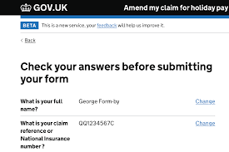
What’s missing and who is not reached
Practitioners: much awareness of who they don’t reach - ‘picking the low hanging fruit’.
Workplace-based curricula and provision? (embedded)
Learners needing help with basic reading and writing?
1-2-1 and phonics
Literacy and digital separated? – digitally mediated reading and writing demands
Older learners and people seeking support with everyday literacy and numeracy practices.
Notes:
Textually dense services – accessing these ; voting - removal of human actors from services and replacement with online services,
E recruitment (Smythe et al. 2021); woman who couldn’t complete the form to access rent reduction she was due
Lit as human capital focussed on industry need and thus narrowed compared to earlier conceptualisations of literacy ; gov only seeing itself responsible for work related skills. But: Industry input/employer voice re skills need but not level of specific practices and no commitment to employer provision – what Karen and others told me, eg fire service, NHS
Individuals seen as responsible to acquire the skills they need to access work, to invest into their human capital; and barriers conceptualised as individual motivational factors or practicalities

Slide 13
What practitioners do
Outreach work (but tailored funding limited + might be used for FS support/bridging classes)
Adapting FS curricula: e.g. including reading for pleasure +
finding suitable examples (students’ own concerns and practices e.g. email to landlord)
‘workarounds’, ‘redo and jig around’ (D, FS English teacher)
Seeking dialogue with students on topics they care about – resisting focus on individual work and exam practice only (Alan, former functional skills tutor)
Using Multiply funding for a class on ‘Counting for Crafts’ (J, practitioner)
BUT: (Ethical) Dilemma - exams/assessment shaping what can be taught.
Notes:
‘there is a scheme of work which I redo and jig around’ (D, but others said the same, and S – for ESOL –said they didn’t even have a scheme of work, that was discouraged;
Experienced teachers use their ability to work with students to:
Ask about their experiences and knowledge (e.g. as parents, on housing) (Allatt and Tett 2019b)
Use that experience to ‘teach’ what is required and to reach the course’s aim (e.g. students to be ‘employment ready’) see Irma/Kate/others

Slide 14



Future of essential skills: what could be done
Document and even measure wider benefits of learning – benefits of of AL re health, citizenship, community life et.
Challenge impact of school discourses, e.g. spelling test at entry level 3 ‘a bit retrograde’
Reconsider content of current programmes.
Support role of community-based actors
Lobby government to reconsider its responsibility for adult learning beyond skills for work:
Not just an incidental ‘add on’
Role of digital practices and separation of adult literacy from digital skills??
Notes:
Document why community-based, learner-centred adult literacies provision (outside of the discourse of functional skills and employability) is needed: Why ‘investing’ into these learners is still valuable - engaging with the economic argument, demonstrating ‘impact’ (e.g. role of informal/non-qualification provision helping people return to learning and gain confidence, Forster, Petrie and Crowther 2018)
Simon: ; spelling test at entry level 3 ‘a bit retrograde’, Simon. Academic drift, is functional skills equivalent or steppingstone to GCSE (see also Cornish 2021

Slide 15
Major William Dunlop
Learning and Development specialist
British Army

Slide 16

Join a breakout session through the links in the chat or on our website!

