Slide 1
Young adult carers training session for staff
Notes:
These slides give an outline session to deliver with staff. It should take around 20-30 minutes. You can tailor the content to your college's processes and add more information about your support for young adult carers. You may also want to add some discussion points around the impact of caring on young people and their experience of college.

Slide 2
Who are young adult carers?

Slide 3
Who are young adult carers?
Young adult carers are young people aged 16-24 who provide unpaid care to someone, usually a member of their family, on a regular basis.
They may care for a parent, sibling, grandparent or other relative who has a disability, long-term illness, mental health problem or other condition which results in a need for care, support or supervision.

Slide 4
Tasks undertaken by young adult carers
Giving and monitoring medication
Physical care – lifting, carrying, moving
Personal care – dressing, washing, help somebody use the toilet
Emotional support
Household chores - cleaning, shopping, cooking
Managing family finances – budgeting, paying bills
Liaising with professionals eg health and social care

Slide 5
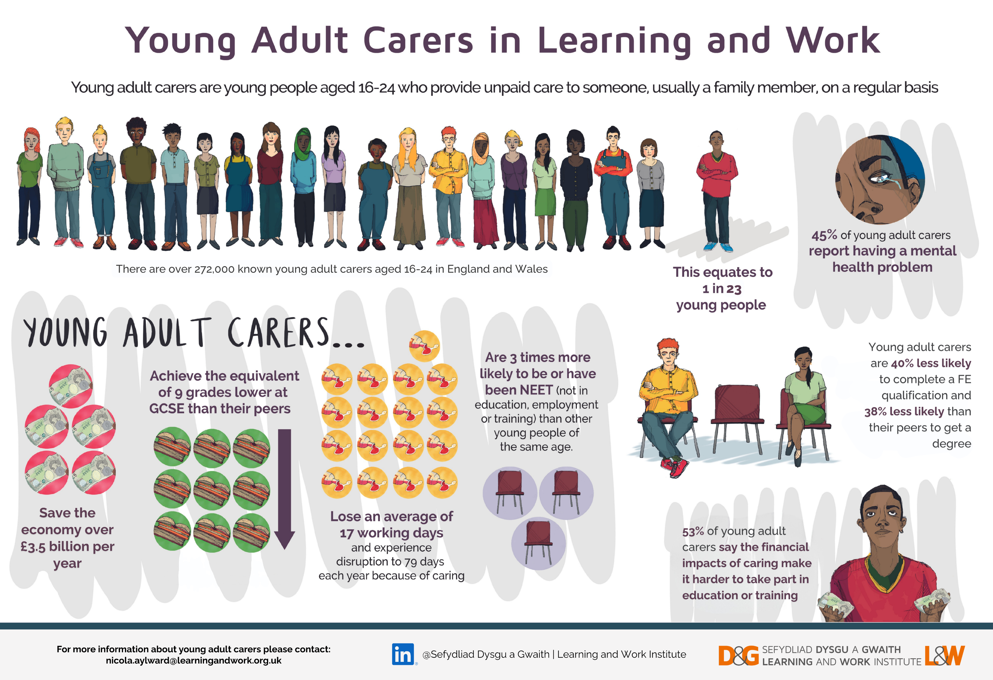

Slide 6
Identifying young adult carers

Slide 7
Signs a student might be a carer
Being late or absent due to responsibilities at home
Displaying feelings of worry and lack of concentration
Missing deadlines
A drop in attainment
Physical problems (e.g. back pain) due to heavy lifting at home
Limited friends or social network due to lack of time to socialise
Constant or regular tiredness

Slide 8
What to do if you think a student might be a carer

Slide 9
Contact student support
The carers lead at college is [add name and details]
If you suspect a student might be a carer, please contact the carers lead
The carers lead will speak to the student to explore reasons behind their behaviour and put a support plan in place
If a young person tells you they are a carer...

Slide 10
Do
Don't
Be understanding and empathetic
Check if they have the support they need in place at college
Tell them that there is support available, if they are unaware
Contact the carers lead to ensure the college is aware
Check in with them regularly and ask how they are doing
Express disbelief
Say something which makes them feel pitied
Keep it to yourself – unless the young person explicitly asks you not to share it and they are safe
Discuss any details about their situation in front of other staff or students

Slide 11
Any questions?

